Slide 1
MRA Project - MileStone 1
Pavan Kalyan B

Slide 2
Introduction:
This project aims to find the underlying buying patterns of the customers of an automobile part manufacturer based on the past 3 years of the Company's transaction data and hence recommend customized marketing strategies for different segments of customers.

Slide 3
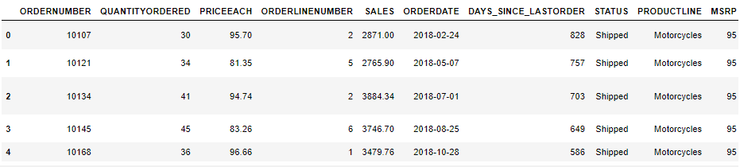
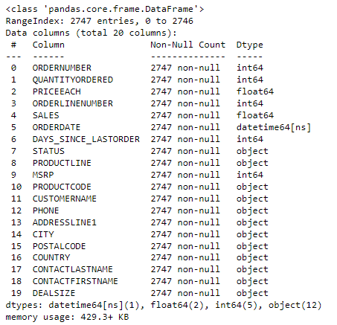
Reading the data and pulling information
We can observe that there are 2-float, 5-int, 12-object
The data uses 429.3+ kilo bytes of memory usage
It contains 2747 rows and 20 columns

Slide 4
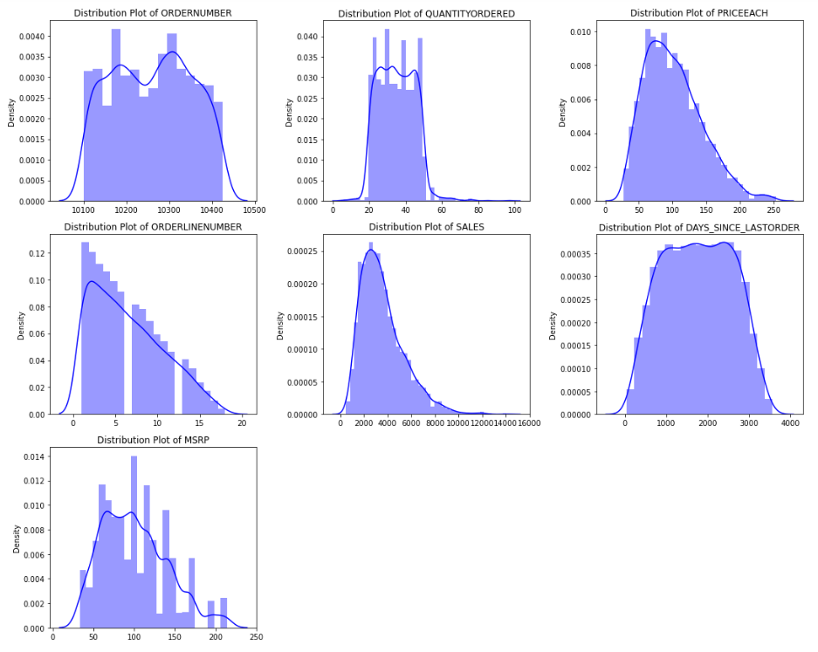
Univariate ANALYSIS - Histogram
The distribution of ‘PRICEEACH’and ‘SALES’ are symmetric in the data
‘MSRP’ is right skewed
Rest all distributions are invalid and are non symmetric in the data

Slide 5
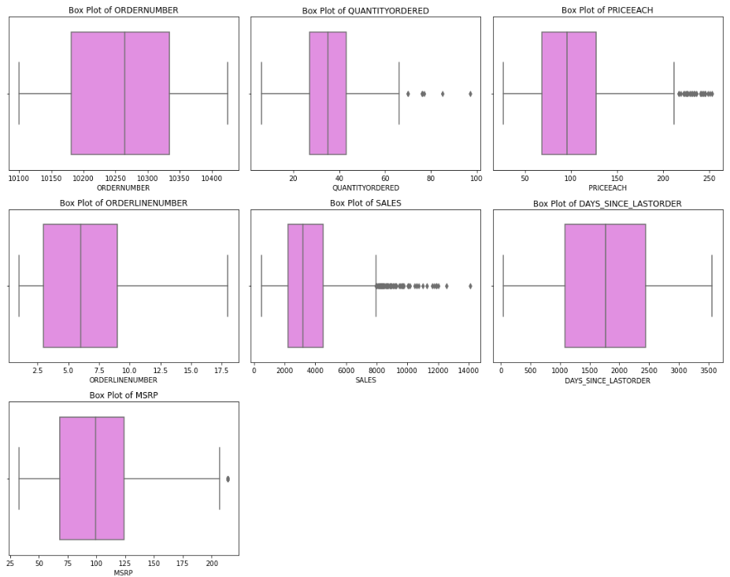
Univariate ANALYSIS - BOXPLOT
We can observe outliers for ‘QUANTITY ORDERED’, PRICEEACH’ ,’SALES’ and ‘MSRP’
Outliers are not treated in this case as we are using RFM analysis

Slide 6
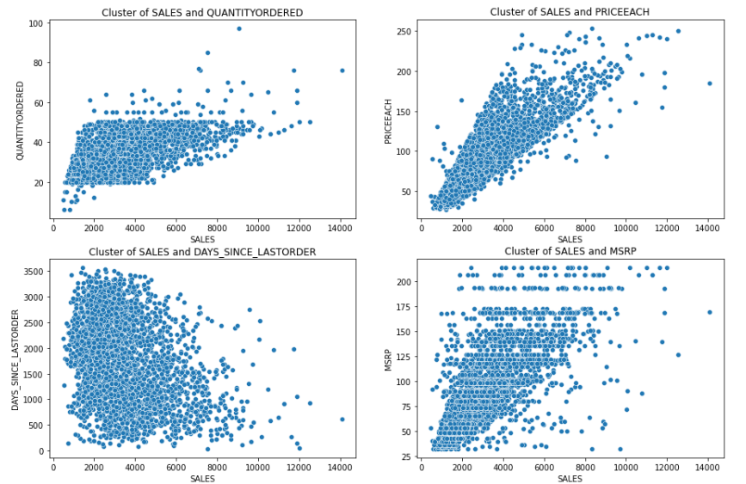
BIVARIATE ANALYSIS – SCATTER PLOT
Cluster of sales and priceeach has a strong correlation
Hence it is positively correlated
Cluster of sales with quantity, days since last order and msrp has no correlation

Slide 7
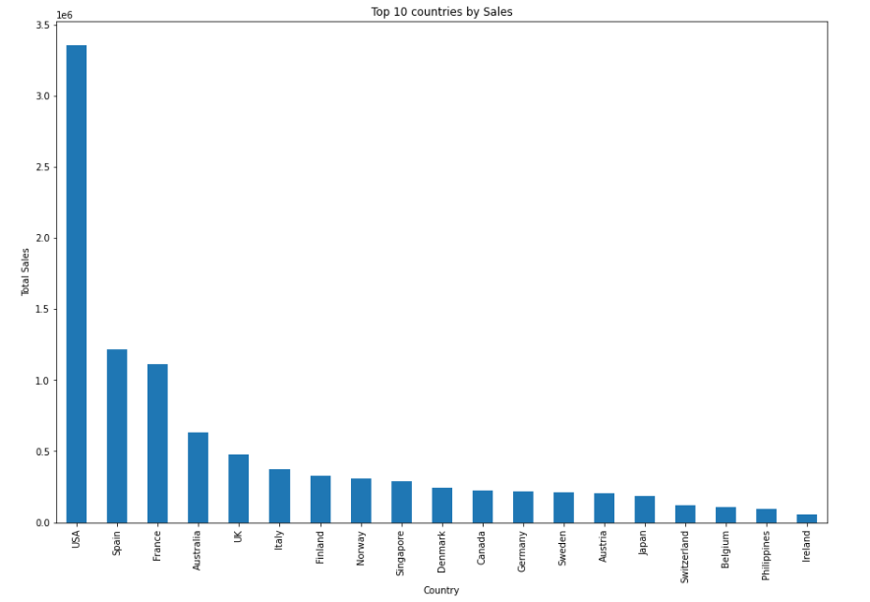
BIVARIATE ANALYSIS – bar PLOT
We can see the top 10 countries by sales
USA is one of the top most in sales than the others
From the top 10 we can observe Ireland is the least one with sales

Slide 8
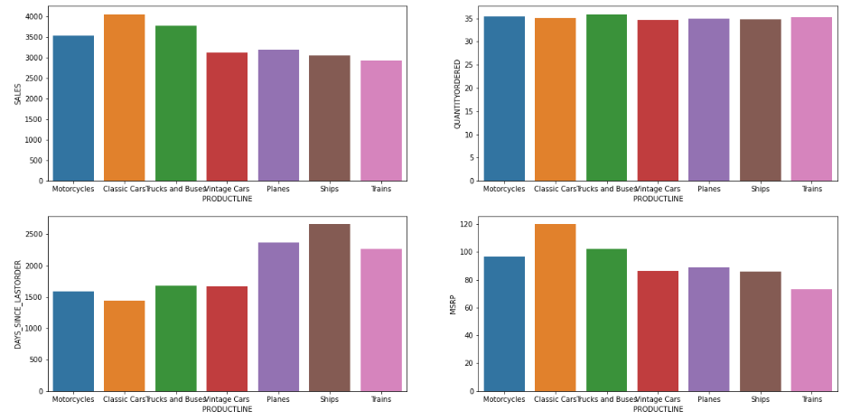
BIVARIATE ANALYSIS – bar PLOT
Analysis based on the product line, we can observe that more quantities are ordered in all categories
Sales were happened high with the ‘Classic cars’
Sales were happened low with the ‘Trains’

Slide 9
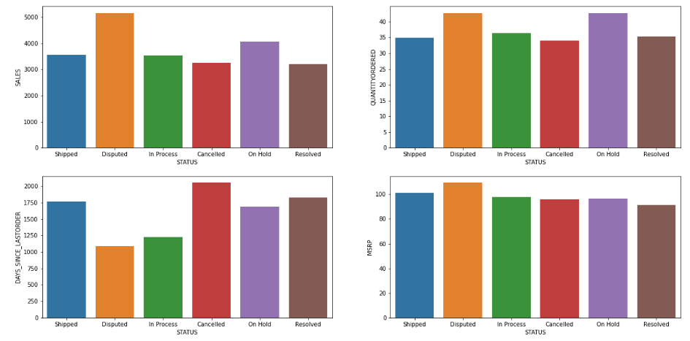
BIVARIATE ANALYSIS – bar PLOT
From the status of sales, msrp, quantity ordered we can observe that most of the products have been dispatched but not yet shipped
From the status of days since last ordered, there are many cancelled orders

Slide 10
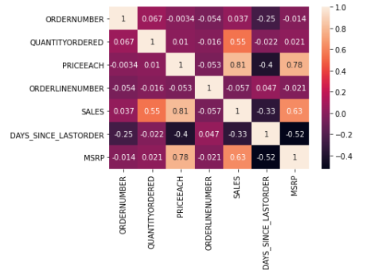
BIVARIATE ANALYSIS – bar PLOT
Sales and Priceeach are highly positively collerated with coeffiecient of correlation=.81
priceeach and MSRP are poistively correlated (0.78) followed by sales and priceeach (0.63)
Sales and order quantity shows a correlation of 0.55.

Slide 11
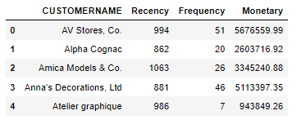
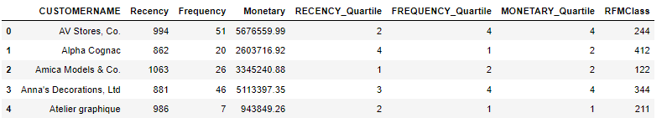
RFM ANALYSIS – (RECENCY, FREQUENCY, MONETARY)
Based on the recency, frequency and monetary their quartiles are found
Frequency_quartile – 1,2,3,4
Monetary_quartile – 1,2,3,4
Recency_quartile – 4,3,2,1

Slide 12
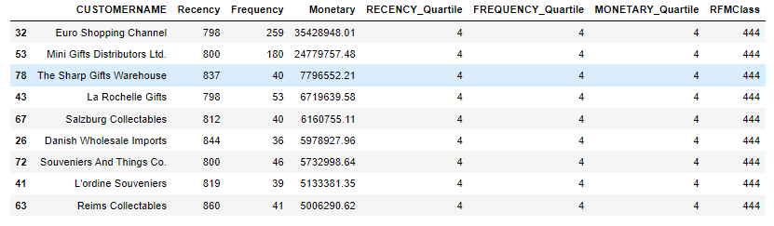
RFM ANALYSIS – (BEST CUSTOMERS)
The above 9 customers are the best one, as they have the RFM of 444 and they used to have a regular transactions
Based on the monetary value these are high valuable customers, where we need to target them to buy more

Slide 13
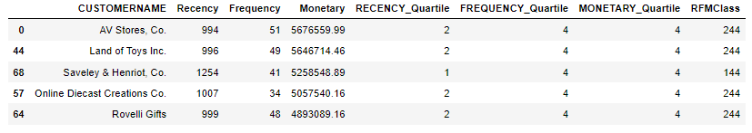
RFM ANALYSIS – (customers are on the verge of churning)
The above 5 customers are the verge of churning
Based on the monetary value these are medium valuable customers, where we need to target them and give discounts and make them to turn to a high valuable customers

Slide 14
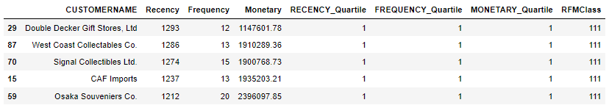
RFM ANALYSIS – (LOST CUSTOMERS)
The above 5 customers are the lost customers
Based on the monetary value and recency they are high valuable but it’s a one time purchase and there is no recency of that person

Slide 15
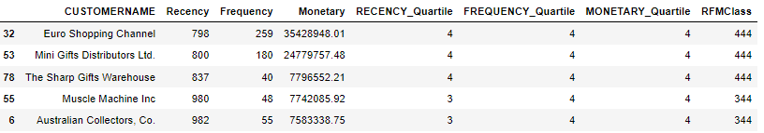
RFM ANALYSIS – (Loyal CUSTOMERS)
The above 5 customers are the loyal customers
Based on the monetary value, frequency and recency they are high valuable and they are loyal means there is a regular transaction

Slide 16
THANK YOU

